Slide 1

Geometry
Unit 6, Lesson 3 Preserving Distance Volume 1, pg. 296

Slide 2


Benchmarks
MA.912.GR.2.2
Identify transformations that do or do not preserve distance.
MA.912.GR.2.3
Identify a sequence of transformations that will map a given figure onto itself or onto another congruent or similar figure.
MA.912.GR.2.5
Given a geometric figure and a sequence of transformations, draw the transformed figure on a coordinate plane.
volume 1, pg. 296

Slide 3
Integrated Mathematical Thinking and Reasoning Standards
MA.K12.MTR.1.1 Actively participate in effortful learning both individually and collectively.
MA.K12.MTR.2.1 Demonstrate understanding by representing problems in multiple ways.
MA.K12.MTR.4.1 Engage in discussions that reflect on the mathematical thinking of self and others.
MA.K12.MTR.5.1 Use patterns and structure to help understand and connect mathematical concepts.
MA.K12.MTR.6.1 Assess the reasonableness of solutions.
volume 1, pg. 296

Slide 4

Learning Targets
I can use a description of a sequence of transformations to determine if the transformation does or does not preserve distance.
I can draw a sequence of transformations to determine if the transformation does or does not preserve distance.
I can identify transformations that do or do not preserve distance.
volume 1, pg. 296

Slide 5

Warm-Up
volume 1, pg. 296

Slide 6
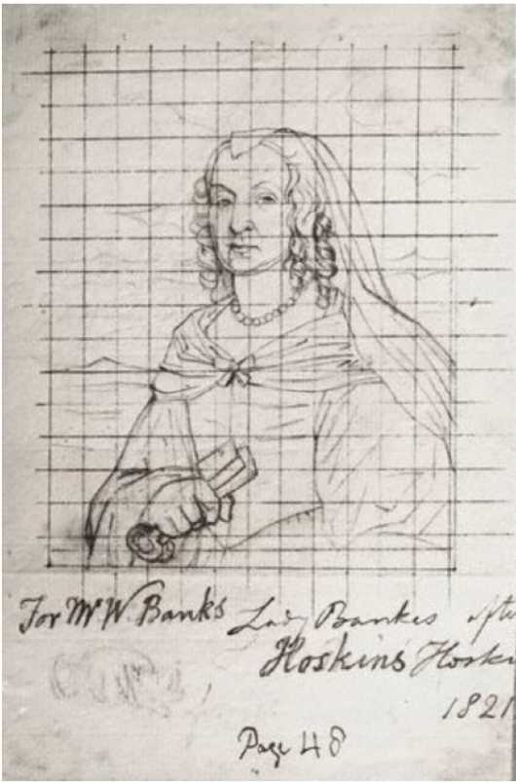
6.3.1 Warm-Up: Notice and Wonder
Artist John Hoskins sketched a drawing of Mary Hawtrey, also known as Lady Mary Bankes, in 1821. Henry Pierce Bone then used the sketch to create an enamel miniature painting.
Following the death of her husband, Lady Mary Bankes successfully defended the Corfe Castle in Dorset, England during a siege in 1643.
Unfortunately, during a second siege in 1646 the castle was destroyed.
volume 1, pg. 296

Slide 7
What do you notice about the sketch of Lady Mary Bankes?
What do you wonder about the sketch of Lady Mary Bankes or her story?
volume 1, pg. 296

Slide 8

Exploration
volume 1, pg. 297

Slide 9

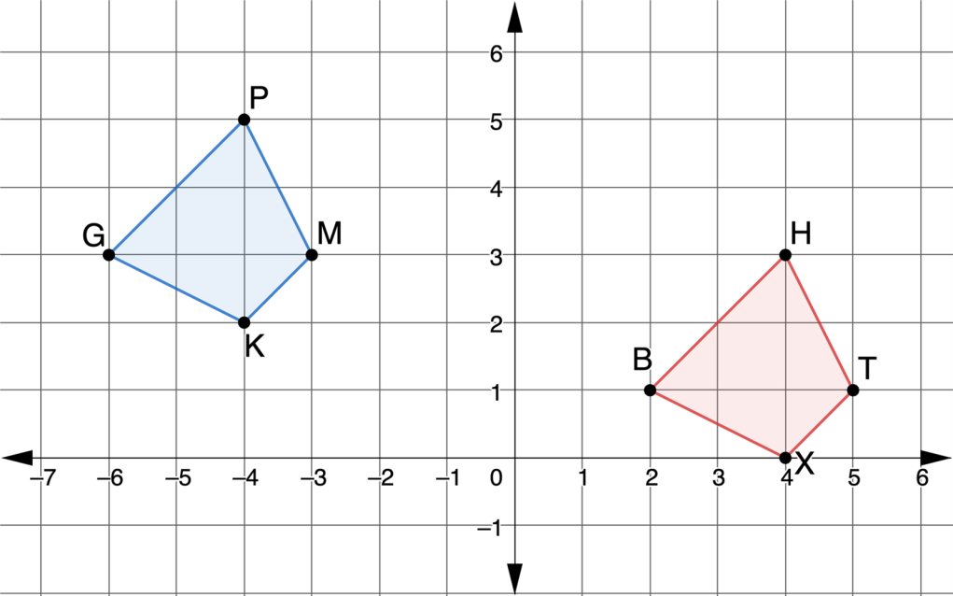
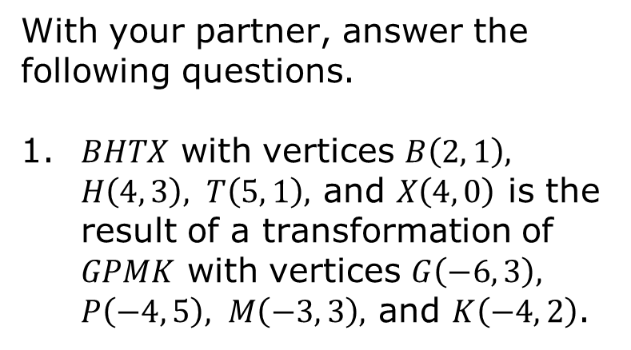
6.3.2 Exploration: Sequence of Transformations
With your partner, answer the following questions.
1. $BHTX$ with vertices $B\left(2, 1\right), H\left(4, 3\right), T\left(5, 1\right),$ and $X\left(4, 0\right)$ is the result of a transformation of $GPMK$ with vertices $G\left(−6, 3\right), P\left(−4, 5\right), M\left(−3, 3\right),$ and $K\left(−4, 2\right)$.
volume 1, pg. 297

Slide 10
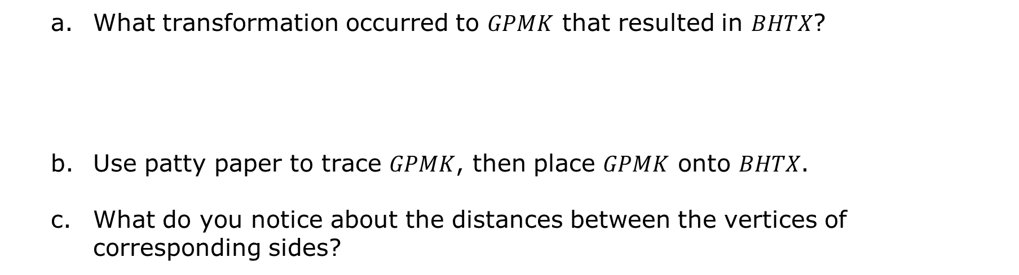
What transformation occurred to $GPMK$ that resulted in $BHTX$?
Use patty paper to trace $GPMK$, then place $GPMK$ onto $BHTX$.
What do you notice about the distances between the vertices of corresponding sides?
volume 1, pg. 297

Slide 11
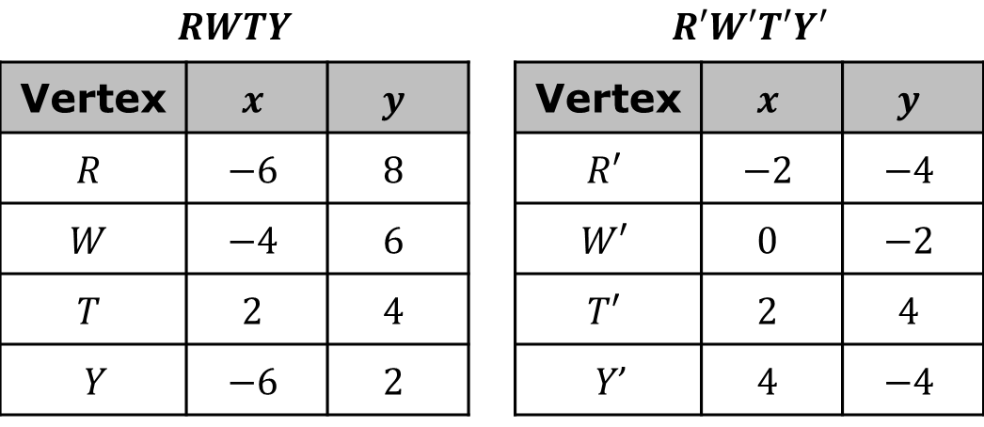
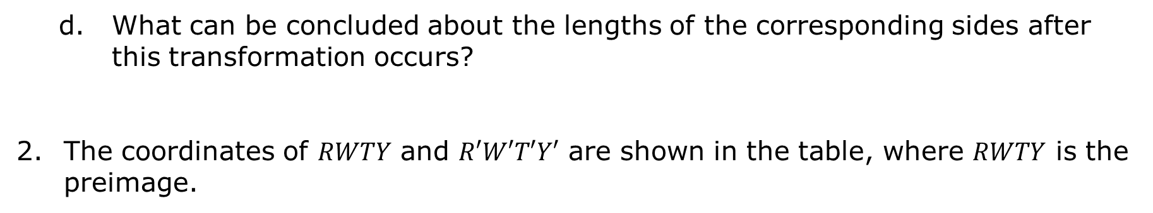
What can be concluded about the lengths of the corresponding sides after this transformation occurs?
The coordinates of $RWTY$ and $R′W′T′Y′$ are shown in the table, where $RWTY$ is the preimage.
$$RWTY$$ |  |  |  | $$R′W′T′Y′$$
Vertex | $$x$$ | $$y$$ |  | Vertex | $$x$$ | $$y$$
$$R$$ | $$−6$$ | $$8$$ |  | $$R′$$ | $$−2$$ | $$−4$$
$$W$$ | $$−4$$ | $$6$$ |  | $$W′$$ | $$0$$ | $$−2$$
$$T$$ | $$2$$ | $$4$$ |  | $$T′$$ | $$2$$ | $$4$$
Y | $$−6$$ | $$2$$ |  | Y’ | $$4$$ | $$−4$$
volume 1, pg. 297

Slide 12
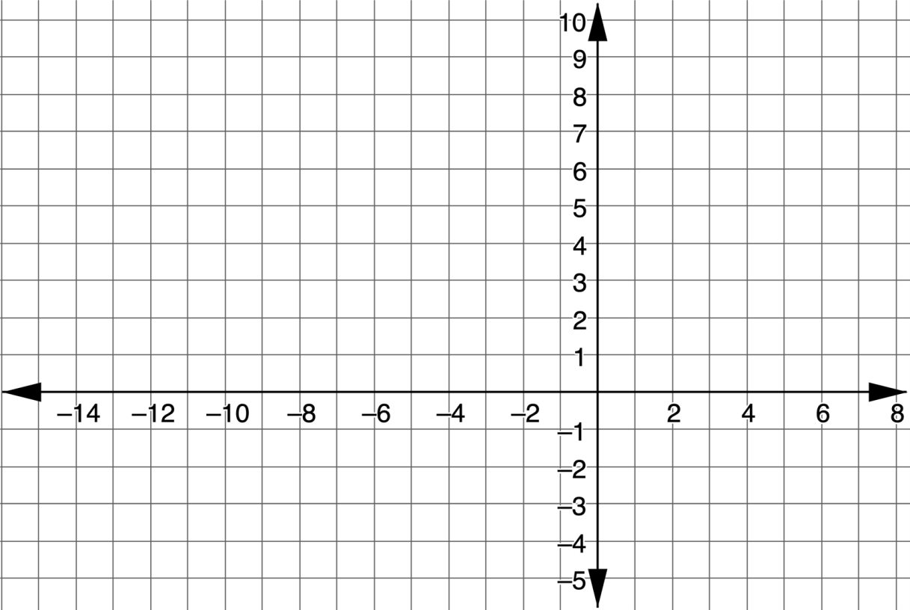
Use the coordinate grid to graph $RWTY$ and $R′W′T′Y′$.
volume 1, pg. 297

Slide 13
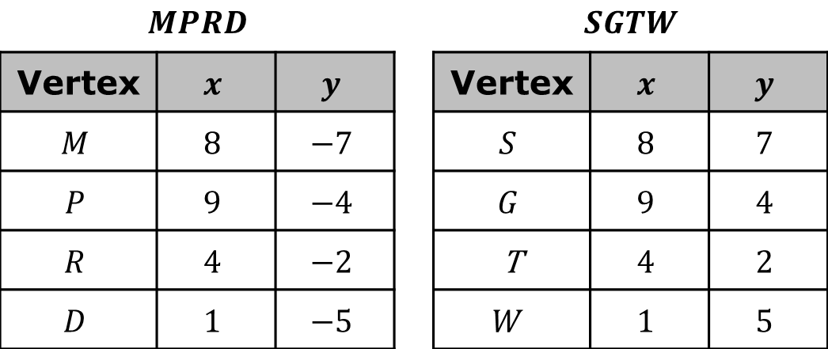
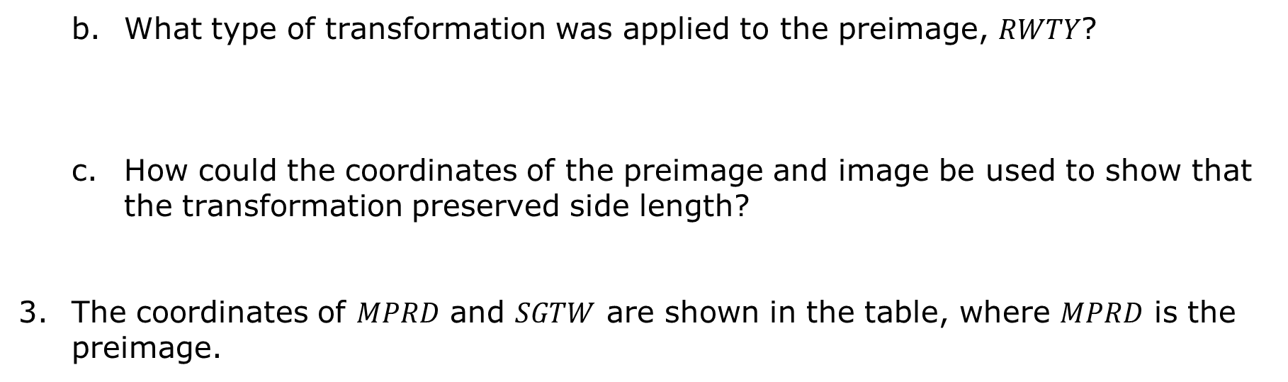
What type of transformation was applied to the preimage, $RWTY$?
How could the coordinates of the preimage and image be used to show that the transformation preserved side length?
The coordinates of $MPRD$ and $SGTW$ are shown in the table, where $MPRD$ is the preimage.
$$MPRD$$ |  |  |  | $$SGTW$$
Vertex | $$x$$ | $$y$$ |  | Vertex | $$x$$ | $$y$$
$$M$$ | $$8$$ | $$−7$$ |  | $$S$$ | $$8$$ | $$7$$
$$P$$ | $$9$$ | $$−4$$ |  | $$G$$ | $$9$$ | $$4$$
$$R$$ | $$4$$ | $$−2$$ |  | T | $$4$$ | $$2$$
$$D$$ | $$1$$ | $$−5$$ |  | $$W$$ | $$1$$ | $$5$$
volume 1, pg. 298

Slide 14
What transformation occurred from the preimage to the image?
Explain how the coordinates of the preimage and image show that the transformation preserved distance.
volume 1, pg. 298

Slide 15
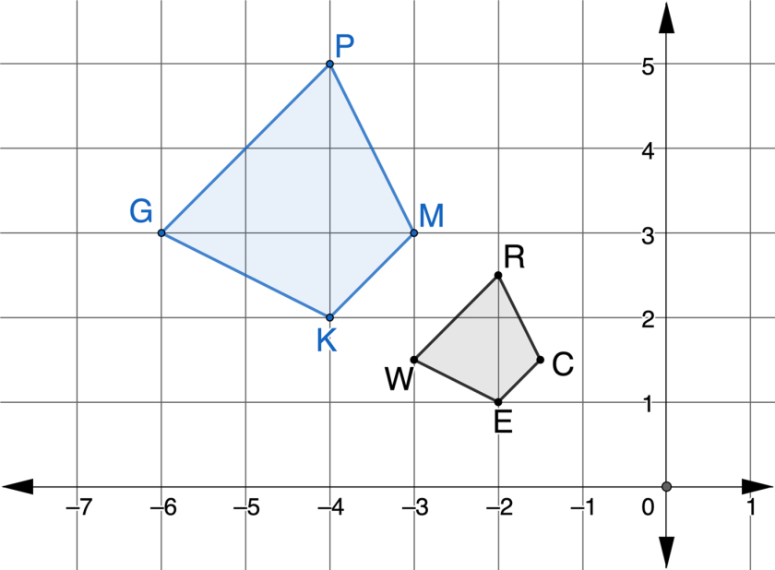
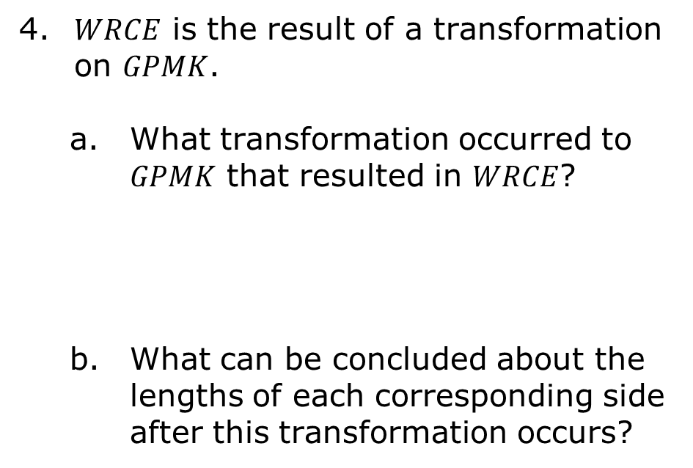
4. $WRCE$ is the result of a transformation on $GPMK$.
What transformation occurred to $GPMK$ that resulted in $WRCE$?
What can be concluded about the lengths of each corresponding side after this transformation occurs?
volume 1, pg. 298

Slide 16

Bring It Together
volume 1, pg. 299

Slide 17

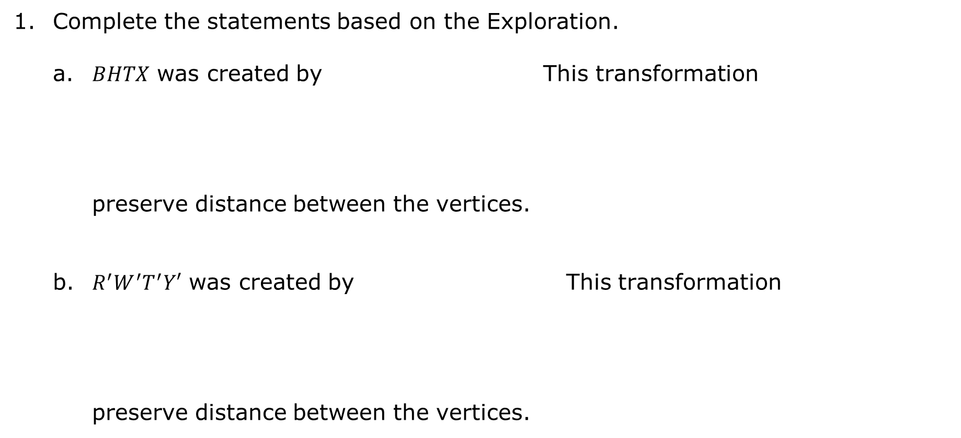
6.3.3 Bring It Together: Preserving Distance
Complete the statements based on the Exploration.
a. $BHTX$ was created by This transformation preserve distance between the vertices.
b. $R^{′}W^{′}T^{′}Y′$ was created by This transformation preserve distance between the vertices.
reflection.
translation.
rotation.
dilation.
does
does not
reflection.
translation.
rotation.
dilation.
does
does not
volume 1, pg. 299

Slide 18

c. $SGTW$ was created by This transformation preserve distance between the vertices.
d. $WRCE$ was created by This transformation preserve distance between the vertices.
reflection.
translation.
rotation.
dilation.
does
does not
reflection.
translation.
rotation.
dilation.
does
does not
volume 1, pg. 299

Slide 19

Guided Instruction
volume 1, pg. 299

Slide 20
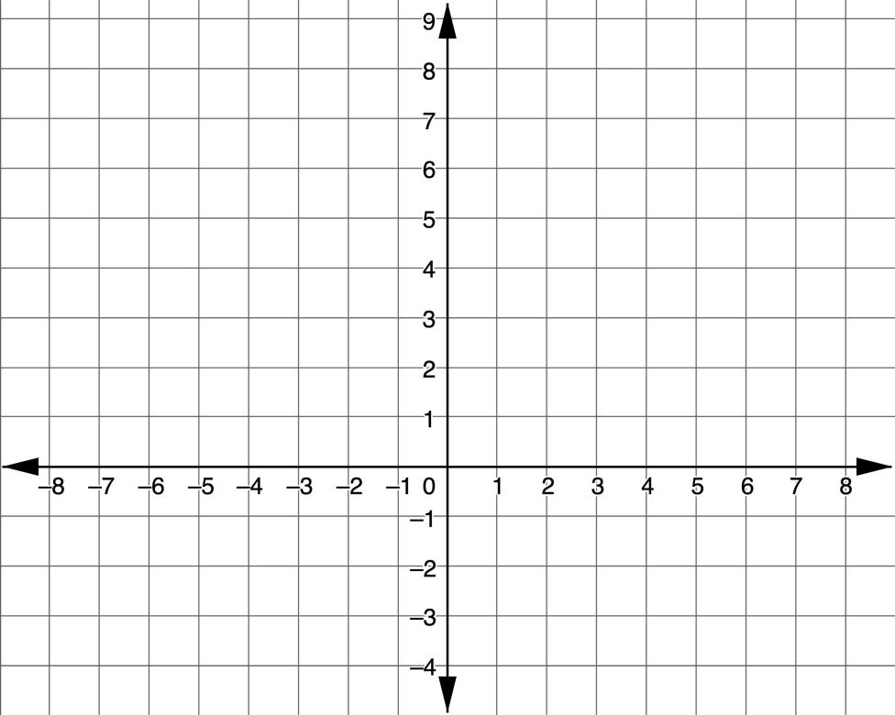
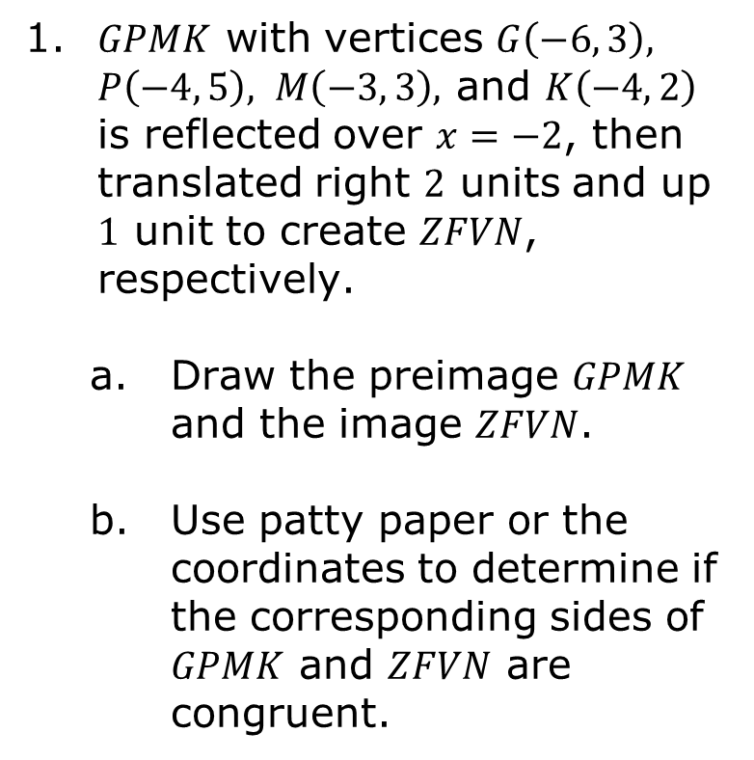
6.3.4 Guided Instruction: Sequence of Transformations and Distance Preservation
1. $GPMK$ with vertices $G\left(−6, 3\right), P\left(−4, 5\right), M\left(−3, 3\right),$ and $K\left(−4, 2\right)$ is reflected over $x=−2$, then translated right $2$ units and up $1$ unit to create $ZFVN$, respectively.
Draw the preimage $GPMK$ and the image $ZFVN$.
Use patty paper or the coordinates to determine if the corresponding sides of $GPMK$ and $ZFVN$ are congruent.
volume 1, pg. 299

Slide 21
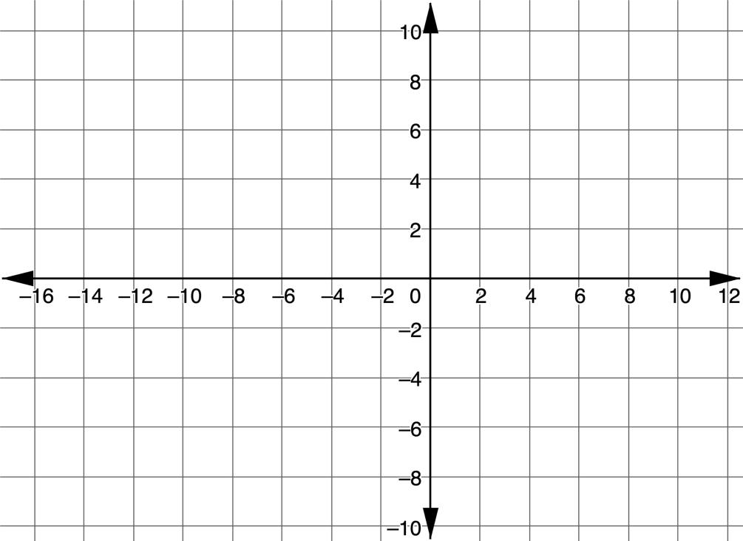
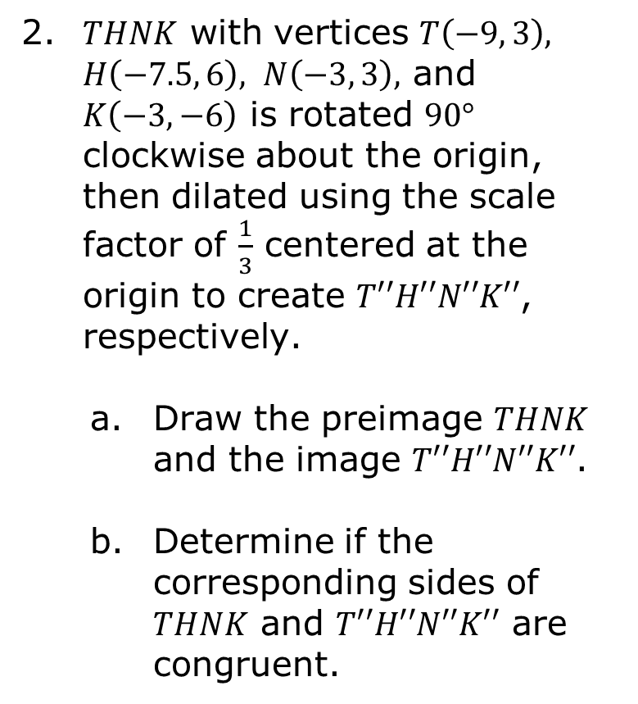
2. $THNK$ with vertices $T\left(−9, 3\right), H\left(−7.5, 6\right), N\left(−3, 3\right),$ and $K\left(−3,−6\right)$ is rotated $90°$ clockwise about the origin, then dilated using the scale factor of $\frac{1}{3}$ centered at the origin to create $T′′H′′N′′K′′$, respectively.
Draw the preimage $THNK$ and the image $T′′H′′N′′K′′$.
Determine if the corresponding sides of $THNK$ and $T′′H′′N′′K′′$ are congruent.
volume 1, pg. 300

Slide 22
Explain how you could use the description of a sequence of transformations to determine if the transformation does or does not preserve distance.
How would your response differ if you were given the coordinates of a sequence of transformations?
volume 1, pg. 300

Slide 23

Wrap-Up
volume 1, pg. 301

Slide 24
6.3.5 Wrap-Up: Reflection
Complete the table.
The terms and information used in the lesson that I knew were … | Something I wondered during the lesson was … | Something I learned during the lesson was …
volume 1, pg. 301

